Slide 1



Topic : HR ANALYTICS
Presenting by GROUP - 4

Slide 2

Team members
1. Vaishnavi Bharambe 2. Sanket Raut 3. Harmanprit Singh Ahdan 4. Athira AM 5. Palash Ghule 6. Abhijeet Gade

Slide 3


Agenda
Introduction to problem statement
Business objective
Kpi’s
Dashboard
Conclusion

Slide 4
Introduction
HR data analysis allows organizations to understand the composition of their workforce, including demographics, skills, and experience levels. This insight is crucial for strategic workforce planning, helping organizations align their human capital with business goals and future needs.
Objectives and scope of the project is to make the insights understandable and help to take appropriate actions and make decision making promptly.

Slide 5
Data Overview
Dataset | HR_1 | HR_2
No. of rows | 50000 | 50000
No. of columns | 18 | 18
File Format | .xlsx | .xslx
Dataset Type | Excel Data | Excel Data

Slide 6
Tools behind this Analysis
EXCEL
POWER BI
TABLEAU
SQL

Slide 7

Problem Statement
Average Attrition rate for all Departments
Average Hourly rate of Male Research Scientist
Attrition rate Vs Monthly income stats
Average working years for each Department
Job Role Vs Work life balance
Attrition rate Vs Year since last promotion relation

Slide 8

Business Objectives The Aim Of This Project Is To Analyze Employees Attrition In The Organization And Provide Insights To The HR Team For Developing Effective Strategies and to make appropriate decision to overcome the cause. Through Data Analysis And Visualization, We Will Identify Factors That Contribute To : - Employees attrition [Attrition rate = 50.21 %] - To verify satisfaction level of employees - Provide recommendations to improve employees attrition - to help for decision making

Slide 9

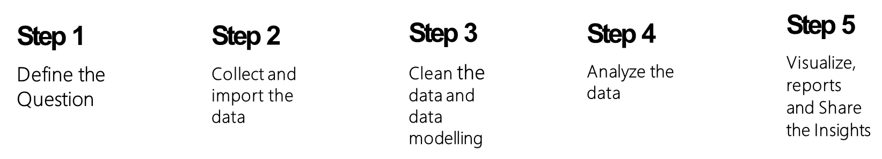
A Roadmap to Effective Analysis

Slide 10
Average Attrition rate for all Departments
This Visual shows the relationship between each department and its attrition rate.
From this result we can conclude that attrition rate is highest for research and development department where as lowest is for hardware department.

Slide 11
Insight from KPI - 1
We can definitely state that the attrition rate of employees for each department is around 50%, indicating that the attrition rate of employees is independent of departments.
As a result, over half of all employees are quitting the organization, regardless of department. We may deduce from this visualization that we must implement strong measures to reduce attrition and boost staff retention in order to balance the company's growth and talent.

Slide 12
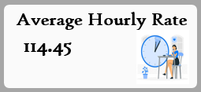
Average Hourly rate of Male Research Scientist
Insights:
This KPI card Is to find out the average hourly rate of male research scientist which is shown In the given card i.e. 114.45

Slide 13
Attrition rate vs monthly income stats
This visual is about to fetch data for attrition rate vs monthly income stats for that there is a monthly income range.
Additionally this also indicates the active employees against attrition.

Slide 14
Insight from KPI - 3
In this visual we have created income ranges on the basis of data and from our analysis and visualization we have conclude that between the income range of 30k to 45k the engagement of attrition and active employees are more as compared to other income ranges.
As per our analysis we cannot say that the attrition cause is because of incomes distribution of employees.

Slide 15
average working years for each departments
This Visual shows average working years for each department.

Slide 16
Insight from KPI - 4
From this visualization we can see that the average working years for software department is high as compared to the rest of the department whereas lowest for research and development department.
From this we analyze and conclude that average working years is approximately 20 years for all Department.

Slide 17
Job role vs work life balance
This Visual shows Job role wise total average work life balance of employees.

Slide 18
Insight from KPI - 5
From this visualization we can have the conclusion that the average work life balance for developers, healthcare representatives, human resources and research scientist is high on the other hand sales representatives have lowest work life balance as compared to the rest.

Slide 19
attrition rate vs last year promotion
This Visual shows attrition rate since last year's promotion

Slide 20
Insight from KPI - 6
From this visualization we can have the conclusion that the attriton rate of human resource is highest then all other job roles whereas research scientist has lowest attriton rate.
Additionally, the maximum average years of promotion is high for the manafacturing director and minimum is for developer role.

Slide 21
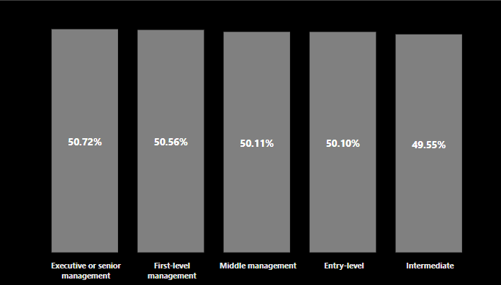
Attrition rate by education
This visual is showing the attrition rate by education level.

Slide 22
Insight from KPI - 7
Based on this visualization, we can conclude that the attrition rate is notably high in the executive or senior management level compared to other levels.
On the other hand, not many people in the middle level are leaving. So, it seems like both the high-ranking and new employees are leaving more often.

Slide 23
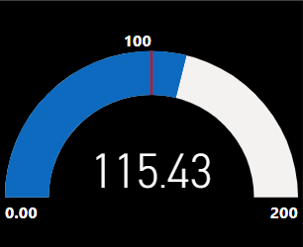
Target of hourly rate
This KPI is showing the Target of hourly rate achieved by the employees.

Slide 24
Insight from KPI - 8
The company set a target of 100, and it's evident that the employees exceeded this goal, achieving a total of 115.43.

Slide 25
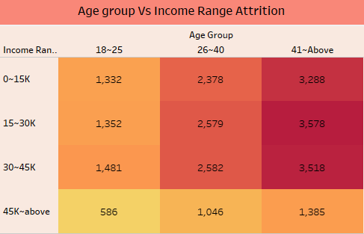
Age group vs income range attrition
This KPI is showing the Age group of Income range wise Attrition count

Slide 26
Insight from KPI - 9
From this visualization we can have the conclusion that the:-
In all Income group range at that time Age group of 41 & above attrition count are more.
In all Income group range at that time Age group of 26-40 attrition count are median.
In all Income group range at that time Age group of 18-25 above attrition count are less.

Slide 27
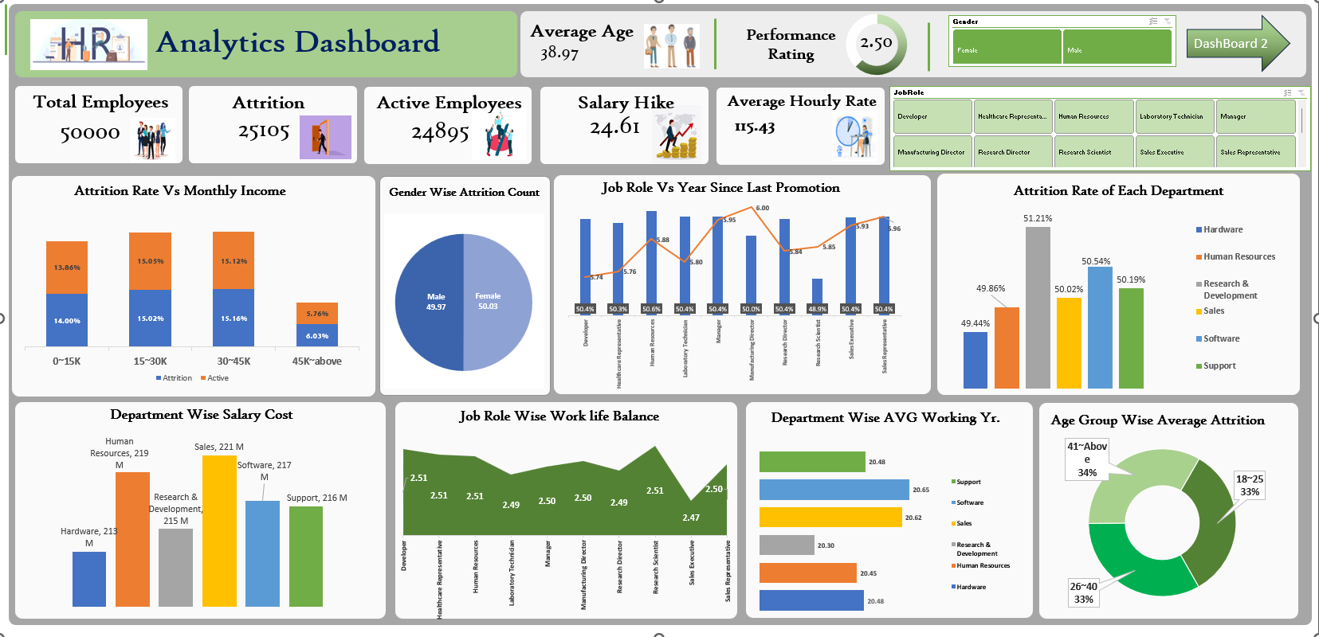

Slide 28
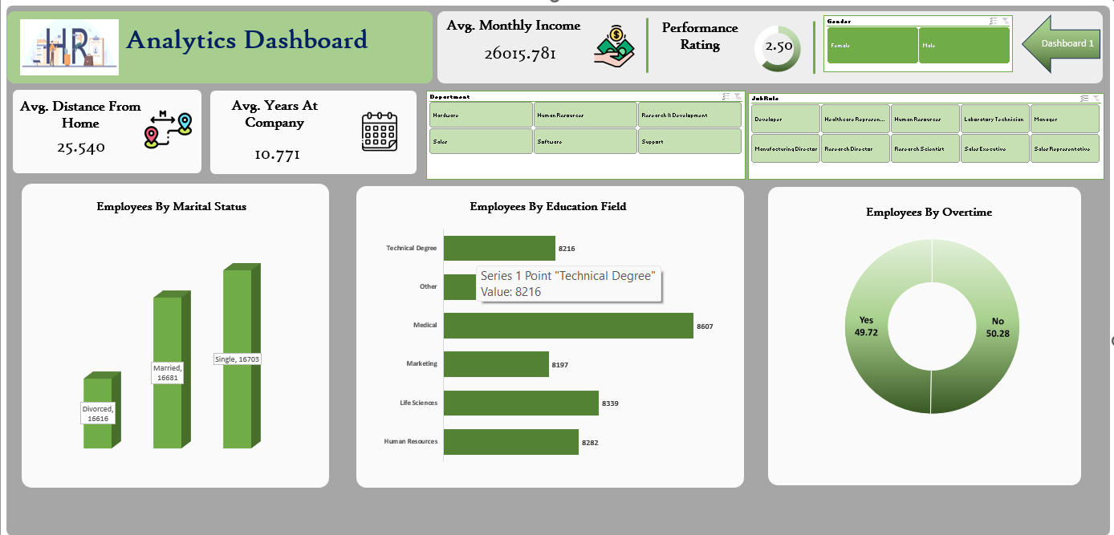

Slide 29
HR analytics is the application of research designs and advance statistical tools for evaluating HR data to find out solutions or to make sustainable decisions relating to HR issues aligning with business strategy. Provide targeted training programs to enhance skills and career development, increasing employee satisfaction Identify high-potential employees and create development plans to retain top talent. Regularly update and refine models and strategies based on new data and evolving organizational dynamics. Implement regular surveys to measure employee engagement and satisfaction. overestimate and appreciate employees contribution towards the growth of organization whether it is less then their capabilities sometimes, it will give them motivation.

Slide 30









Slide 31

This project lays the foundation for informed HR decisions, fostering a workplace that attracts, retains, and nurtures top talent.

